Slide 1
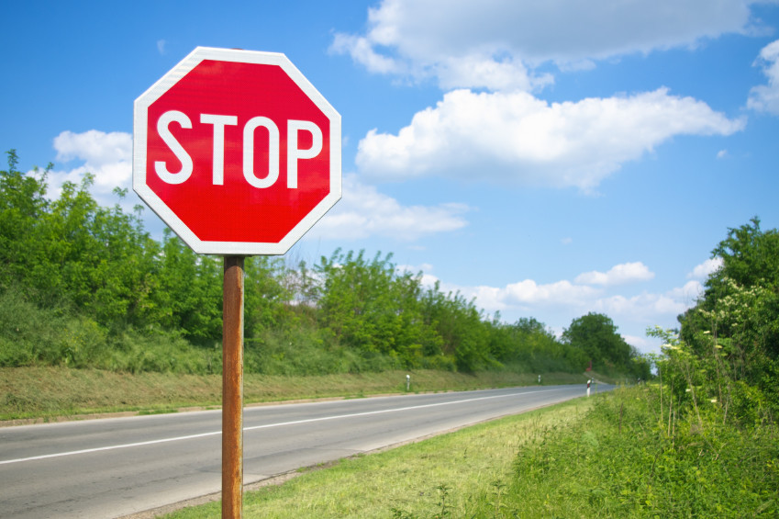


Traffic Sign Classification with CNN and
Transfer Learning
Advanced Machine Learning
João Faia – 47051
Tomás Oom – 59447

Slide 2
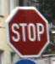
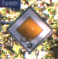
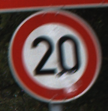
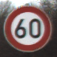
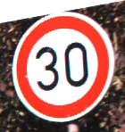
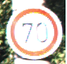

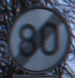
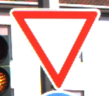
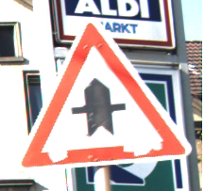
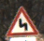
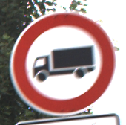
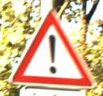
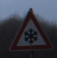
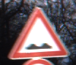
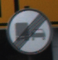
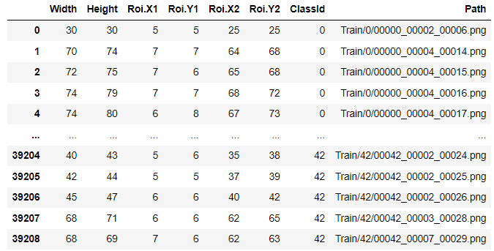
GTSDB - German Traffic Sign Dataset Benchmark
51839 Images
Train
Validation
75%
25%
39209 Images
12630 Images
43 Classes
Additional information:
Width and height
Region of interest (ROI)
Few examples of traffic signs from train set

Slide 3
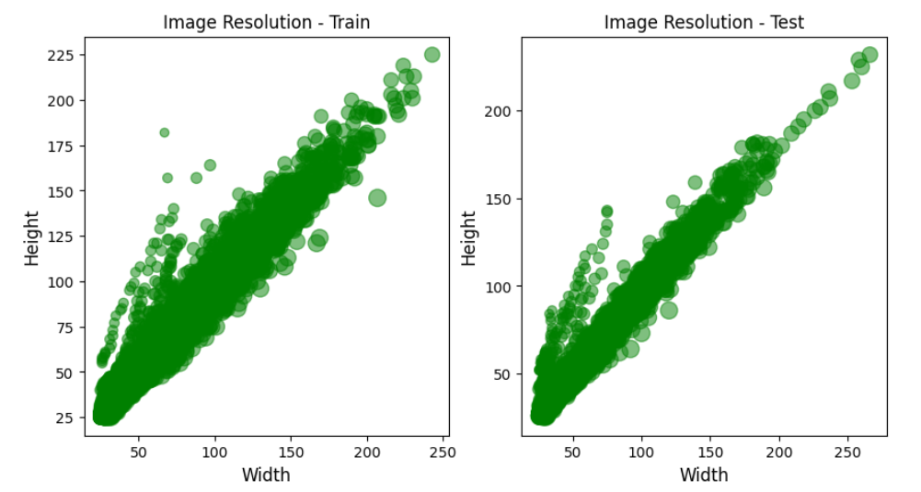
GTSDB - German Traffic Sign Dataset Benchmark
51839 Images
Train
Validation
75%
25%
39209 Images
12630 Images
43 Classes
Resize all images to 32x32
Mainly 1:1 aspect ratio – Images less affected by resize
Notes:
A figura 1 permitiu ter uma ideia da distribuição das resoluções presentes nas imagens do dataset, sendo essencial para os modelos um redimensionamento para que todas fiquem do mesmo tamanho (tamanho determinado na camada de input).
1 - Tendo em conta que o poder computacional necessário para treinar os modelos é tanto maior quanto maior o número de pixéis, foi decidido realizar um redimensionamento de todas as imagens para uma resolução 32x32.
2 - A redução de imagens através da remoção de pixéis, permite a preservação de certas características presentes originalmente, sendo esta abordagem, neste caso, preferível. (Do que upsampling)

Slide 4
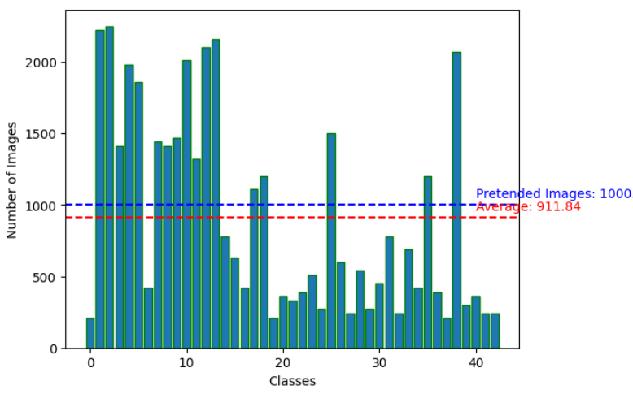
GTSDB - German Traffic Sign Dataset Benchmark
Imbalanced class distribution
>1000: Image reduction
<1000: Data augmentation
Reduce overfit
Notes:
A figura 2 permite perceber que o conjunto de dados se encontra bastante desequilibrado, contendo classes com aproximadamente 200 imagens e outras com 2000.

Slide 5
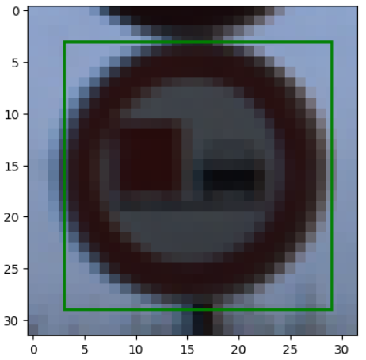
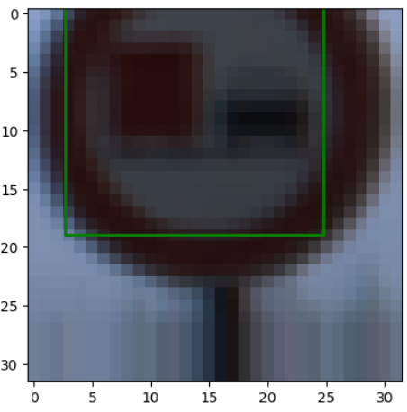
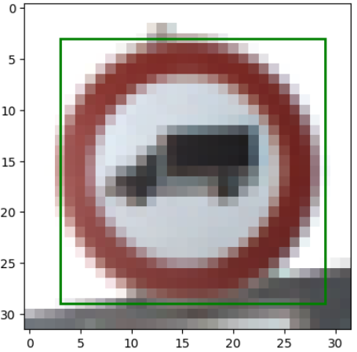
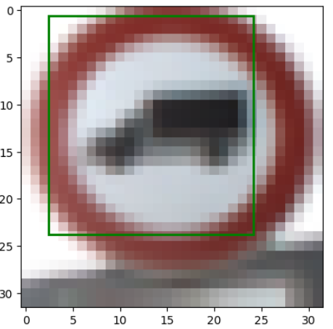
Data Augmentation
Keras . ImageDataGenerator
0.2 of total width to right/left
0.2 of total height up/down
Zoom in/out of up to 20%
ROI values also adjusted
Notes:
A figura 2 permite perceber que o conjunto de dados se encontra bastante desequilibrado, contendo classes com aproximadamente 200 imagens e outras com 2000.

Slide 6
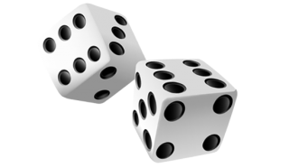
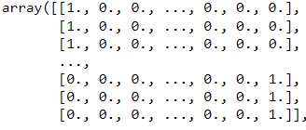
Data Preprocessing
Pixel normalization
One-hot encode labels
Shuffle data

Slide 7
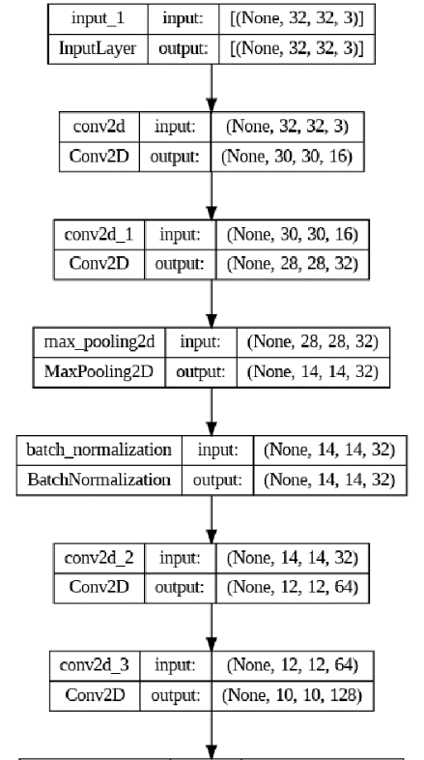
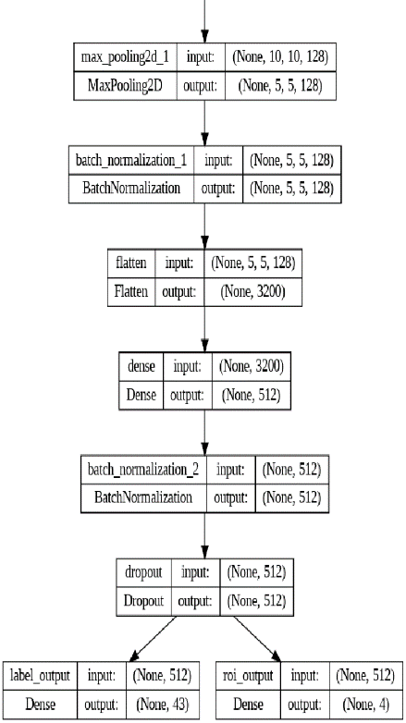
Convolutional Neural Networks
2 different Architectures
Classify traffic signs and predict ROI
30 Epochs
32 Batch size
Validating while training
Optimization Algorithm: Adaptive Moment Estimation

Slide 8
CNN - 1
Input 32x32x3
Convolutional Layer
Convolutional Layer
Convolutional Layer
16 Filters
32 Filters
MaxPooling (2x2)
64 Filters
Kernel size 3x3
Kernel size 3x3
BatchNormalization
Kernel size 3x3
ReLU
ReLU
ReLU
Convolutional Layer
Dense Layer
128 Filters
MaxPooling (2x2)
512 Neurons
BatchNormalization
Kernel size 3x3
BatchNormalization
ReLU
Dropout 50%
ReLU
Flatten
Output Layer Classification
Output Layer ROI
43 Units
4 Units
Softmax
Linear
Loss: Categorical cross-entropy
Loss: Mean Squared Error

Slide 9
CNN - 2
Input 32x32x3
Convolutional Layer
Convolutional Layer
Convolutional Layer
8 Filters
16 Filters
MaxPooling (2x2)
16 Filters
Kernel size 5x5
Kernel size 3x3
BatchNormalization
Kernel size 3x3
ReLU
ReLU
ReLU
Convolutional Layer
Convolutional Layer
32 Filters
MaxPooling (2x2)
32 Filters
MaxPooling (2x2)
Kernel size 3x3
BatchNormalization
Kernel size 3x3
BatchNormalization
ReLU
ReLU
Flatten
Dense Layer
128 Neurons
BatchNormalization
ReLU
Dropout 50%
Output Layer Classification
Output Layer ROI
43 Units
4 Units
Softmax
Linear
Loss: Categorical cross-entropy
Loss: Mean Squared Error

Slide 10
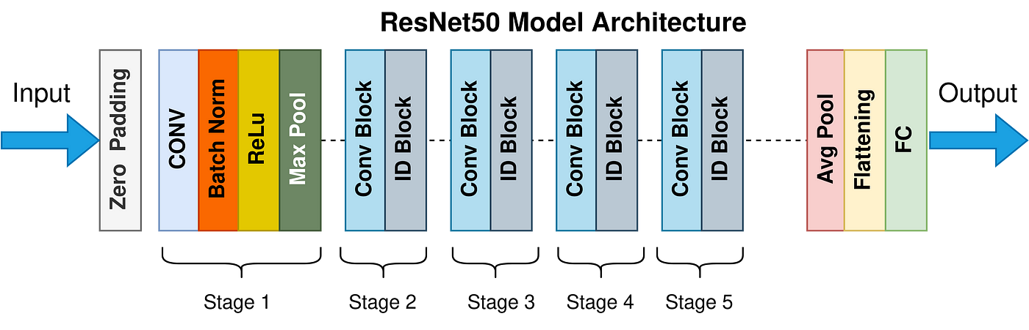
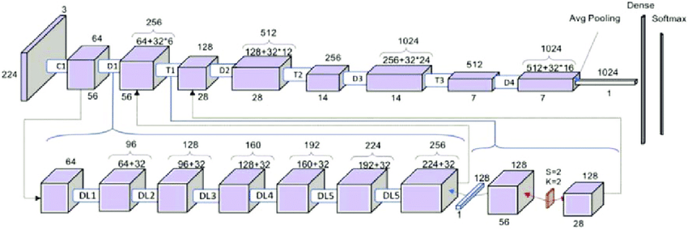
Transfer Learning
ResNet50 and DenseNet121
Pre-trained on ImageNet
All weights frozen
Added both output layers
Added fully connected layer with 512 units
Dropout 50%
DenseNet121 Model Architecture

Slide 11
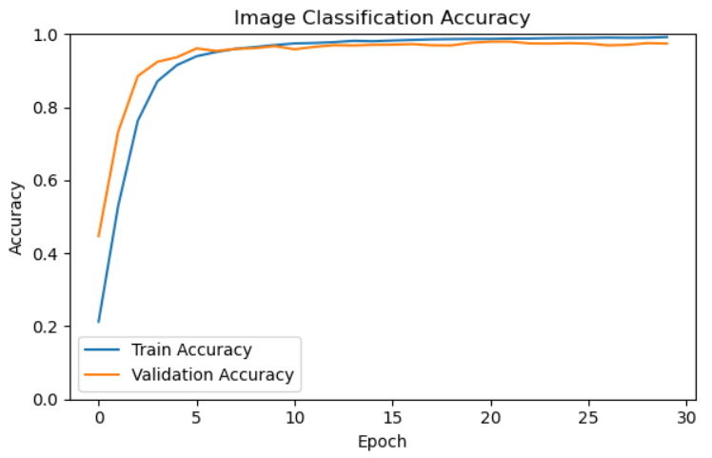
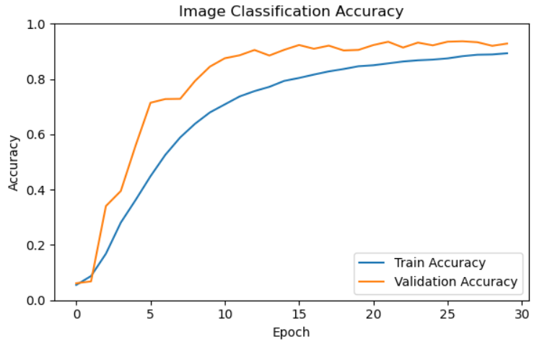
Results
CNN-1
CNN-1 vs CNN-2
Classifying Task
CNN-1 stabilized faster
CNN-2 better validation accuracy than train: Good regularisation
CNN-1 better accuracy – 0.97
CNN-1 filters capture more high level features than CNN-2
CNN-2

Slide 12
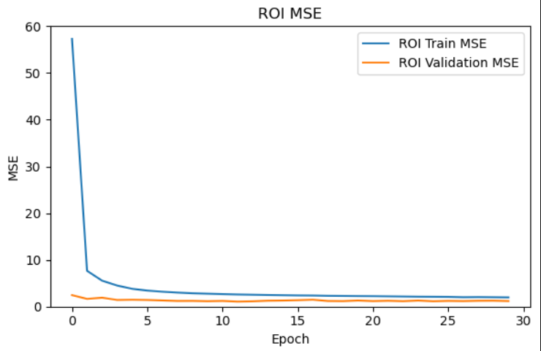
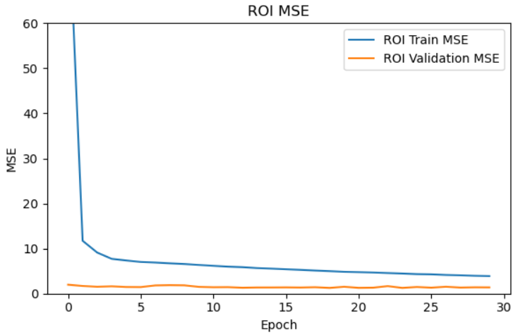
Results
CNN-1
CNN-1 vs CNN-2
Predicting ROI
Very similar results
CNN-1 slightly better MSE – 1.19
Small error overall
CNN-2

Slide 13
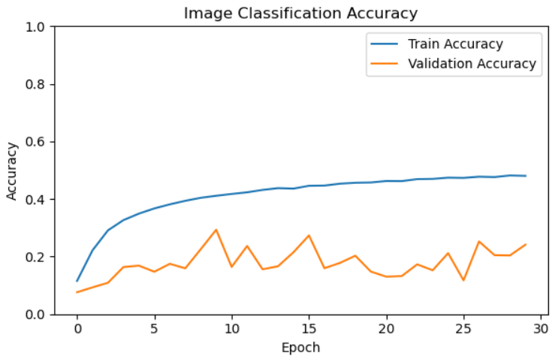
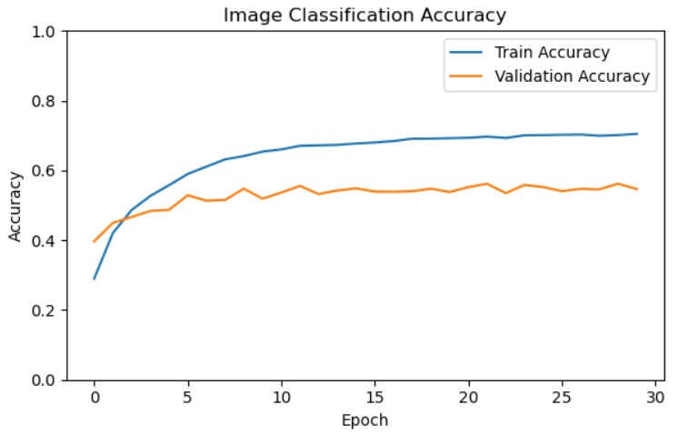
Results
ResNet50
ResNet50 vs DenseNet121
Classifying Task
Both models are underfit
DenseNet121 2x more accuracy than ResNet50
DenseNet121 has more layers, possibly capturing more features
For a frozen model, an accuracy of 0.55 indicates a slight generalisation
DenseNet121

Slide 14
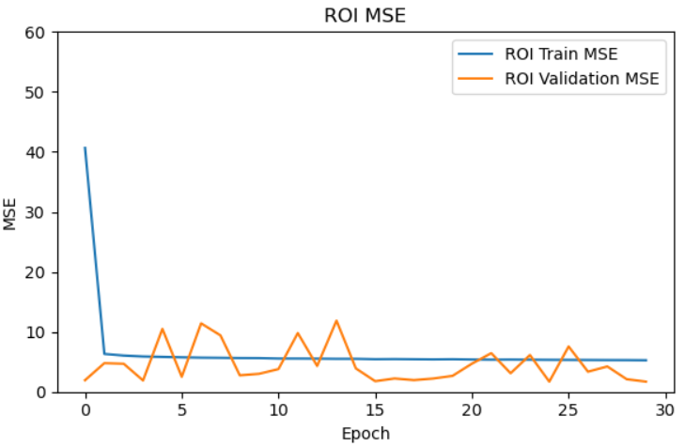
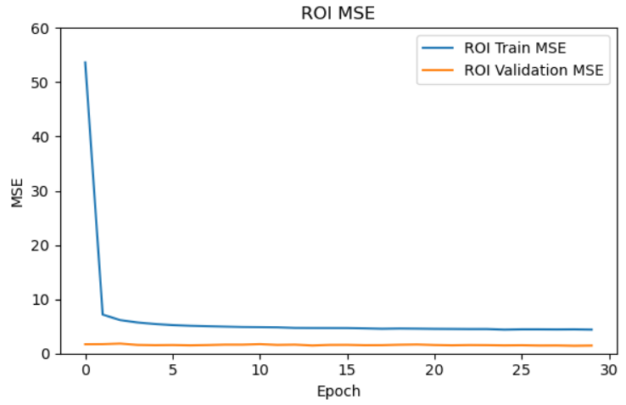
Results
ResNet50
ResNet50 vs DenseNet121
Predicting ROI
MSE values not far from previous CNNs
Possibly suggests that full connected layer of 512 units is enough to predict ROI
DenseNet121

Slide 15
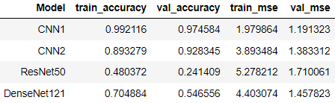
Results
Overall
CNNs achieved better results
Fine-tuning essential for performance
CNN-1 was the best model

Slide 16
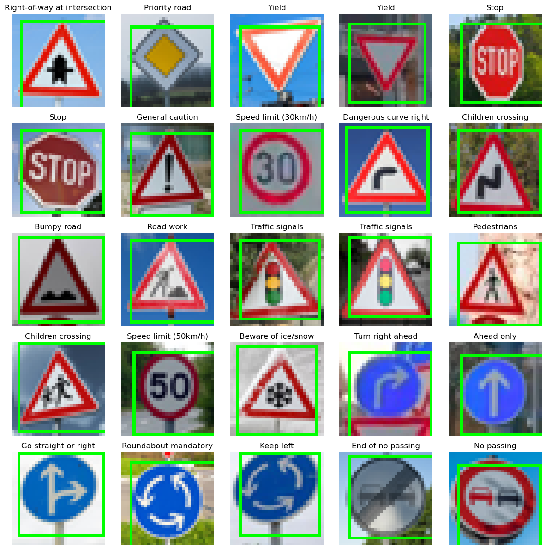
Test
Testing CNN-1 with 25 independent images from the Internet
Adequate ROI placement
2 incorrectly labeled images
Accuracy of 0.92

Slide 17
Final Remarks
Good performance with a relatively simple model
Limited computational power for fine-tuning and other considered approaches
Freeze only a part of the weights instead of totally
Increase number of tested images allowing for better confidence

Slide 18

THANK YOU
Advanced Machine Learning
João Faia – 47051
Tomás Oom – 59447

Slide 19
